Slide 1
BIG DATA
Running a data platform

Slide 2
Migration
Goals
Evaluating the costs for a cloud/on-premises data platform
Fill in this table
Cost | On-premises | On cloud
Hardware | ? | ?
Software | ? | ?

Slide 3
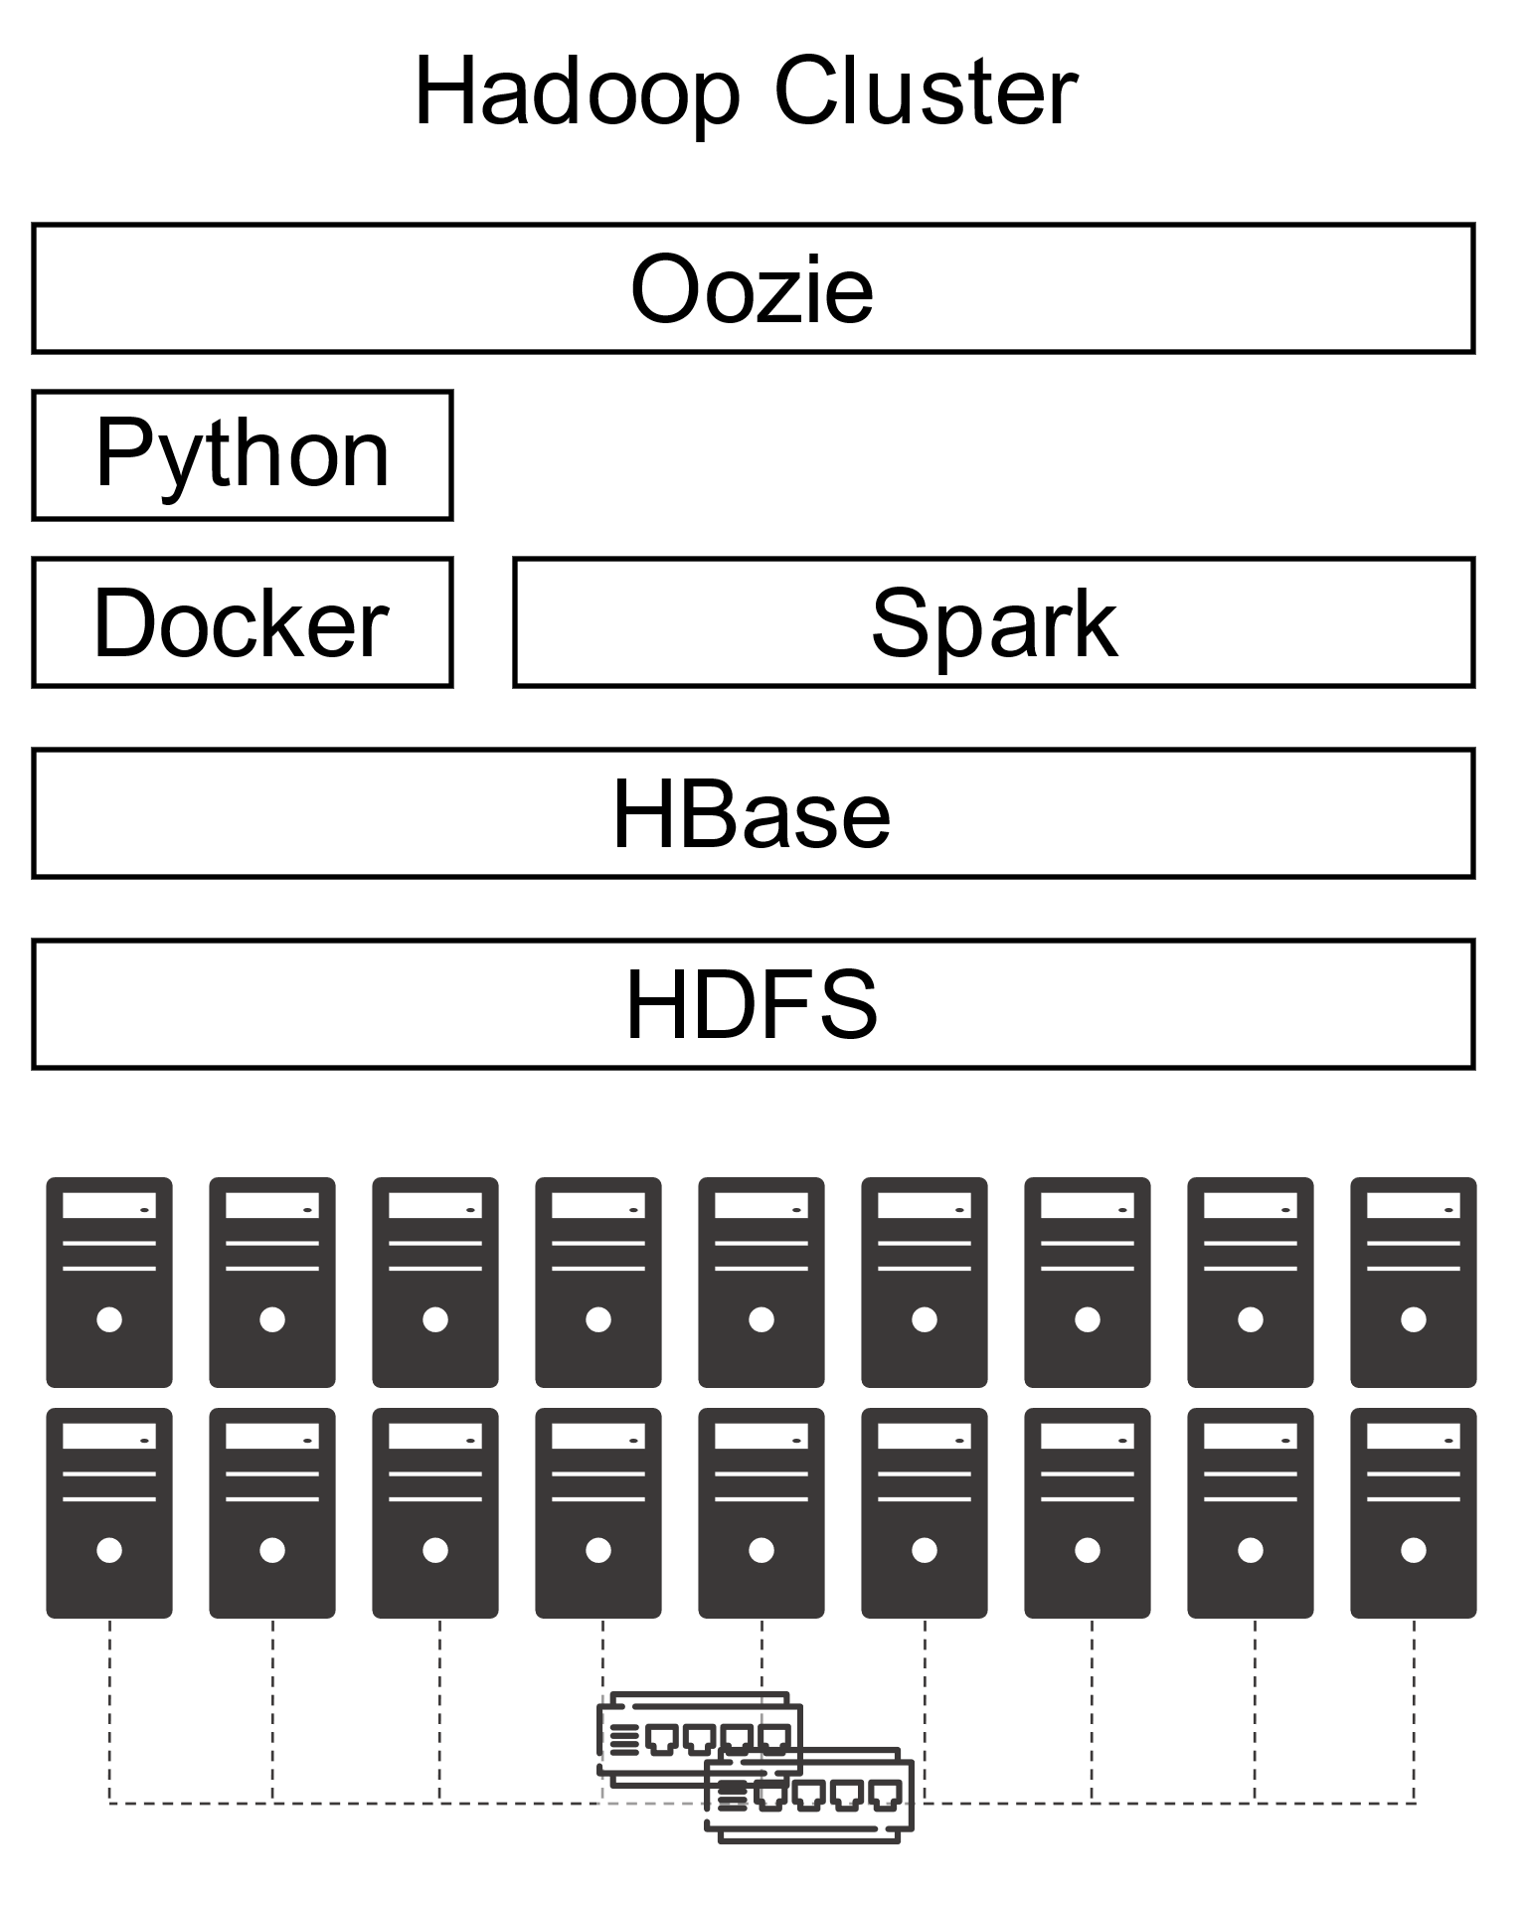
Migration
Reference architecture

Slide 4


Migration
Hardware
Software
"Classic" Hadoop stack
8 CPUs (144 total)
- Intel(R) Core(TM) i7-8700 CPU @ 3.20GHz
32GB RAM (576GB total)
- 2 x 16GB DIMM DDR4 2666 MHz
12TB HDD Disk (216TB total)
- 3 x 4TB ST4000DM004-2CV1
lshw -short -C cpu
lshw -short -C memory
lshw -short -C disk

Slide 5
Migration
SOL_{onprem} | On-premises | On cloud
Hardware | ? | ?
Software | ? | ?
Hardware cost: ?
Refer to https://www.rect.coreto-europe.com/en/search.html?clearsearch=1

Slide 6
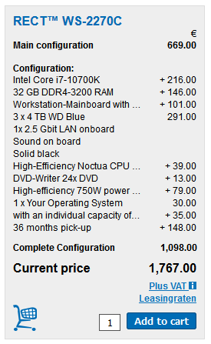
Migration
SOL_{onprem} | On-premises | On cloud
Hardware | 10602€/year | ?
Software | ? | ?
Hardware cost (up to Mar 05, 2021): 1767€ x 18 = 31806€
Amortization over 3 years (i.e., 10602€/year)

Slide 7
Migration
SOL_{onprem} | On-premises | On cloud
Hardware | 10602€/year | ?
Software | 0€ | ?
Software cost: ?

Slide 8
Migration
SOL_{onprem} | On-premises | On cloud
Hardware | 10602€/year | ?
Software | 0€ | ?
Software cost (up to 2020): 0€
Free Cloudera Management System
No software licensing (for research purpose)

Slide 9
Migration
SOL_{onprem} | On-premises | On cloud
Hardware | 10602€/year | ?
Software | 180000€/year | ?
Software cost (up to Mar 05, 2021): 10000€/year x 18 = 180000€/year
Cloudera is no more free, 10K€ per node
https://www.cloudera.com/products/pricing.html#private-cloud-services
https://www.cloudera.com/products/pricing/product-features.html
No license for research purpose
“Houston we’ve had a problem!”
We cannot update/extend the cluster anymore
What about migrating to the cloud? (we only consider AWS)

Slide 10
Migration
Moving a Hadoop cluster to the cloud (we only consider AWS)
AWS price calculator https://calculator.aws/#/estimate
How do we start?
We have already defined the hardware and the software stack
Start with coarse tuning, identify the dominating costs first
Is it computing, storage, or processing?
Identify a suitable budget, implement, refine later
Wrong refinements can do a lot of damage

Slide 11
Migration
SOL_{cloud1} | On-premises | On cloud
Hardware | 10602€/year | ?
Software | 180000€/year | ?
Migrating the cluster as-is: ?
Hint: add 18 EC2 instances satisfying the hardware requirements

Slide 12
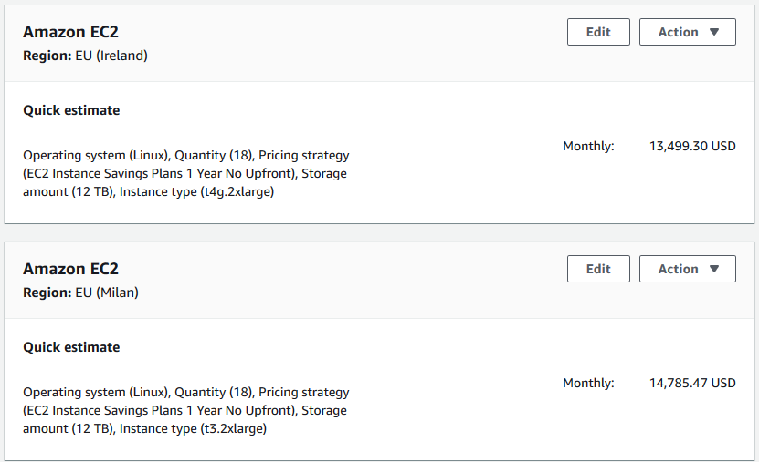
Migration
SOL_{cloud1} | On-premises | On cloud
Hardware | 10602€/year | 162000$/year
Software | 180000€/year | ?
SOL_{cloud1} migrating the cluster as-is: 13500$/month = 162000$/year
18 EC2 instances (t4g.2xlarge) with 12TB EBS storage each machine
Still, we have no software configuration
https://calculator.aws/#/estimate?id=7757afffccc3cafdcfdeb212b74623ef02ed5a36

Slide 13
Migration
Pay attention to the region
Different regions, different prices
Different regions, different services
Remember the GDPR and data locality

Slide 14
Migration
It makes no sense to move the cluster as-is
More machines ensure better (on-prem) scalability but higher costs
How do we proceed with the migration?
We need minimum software requirements
Try to achieve the smallest migration impact
Find the most similar cloud-based solution to a Hadoop cluster
Rethink applications (later) when you got the know-how
Identify a suitable budget, implement, refine later
Wrong refinements can do a lot of damage

Slide 15
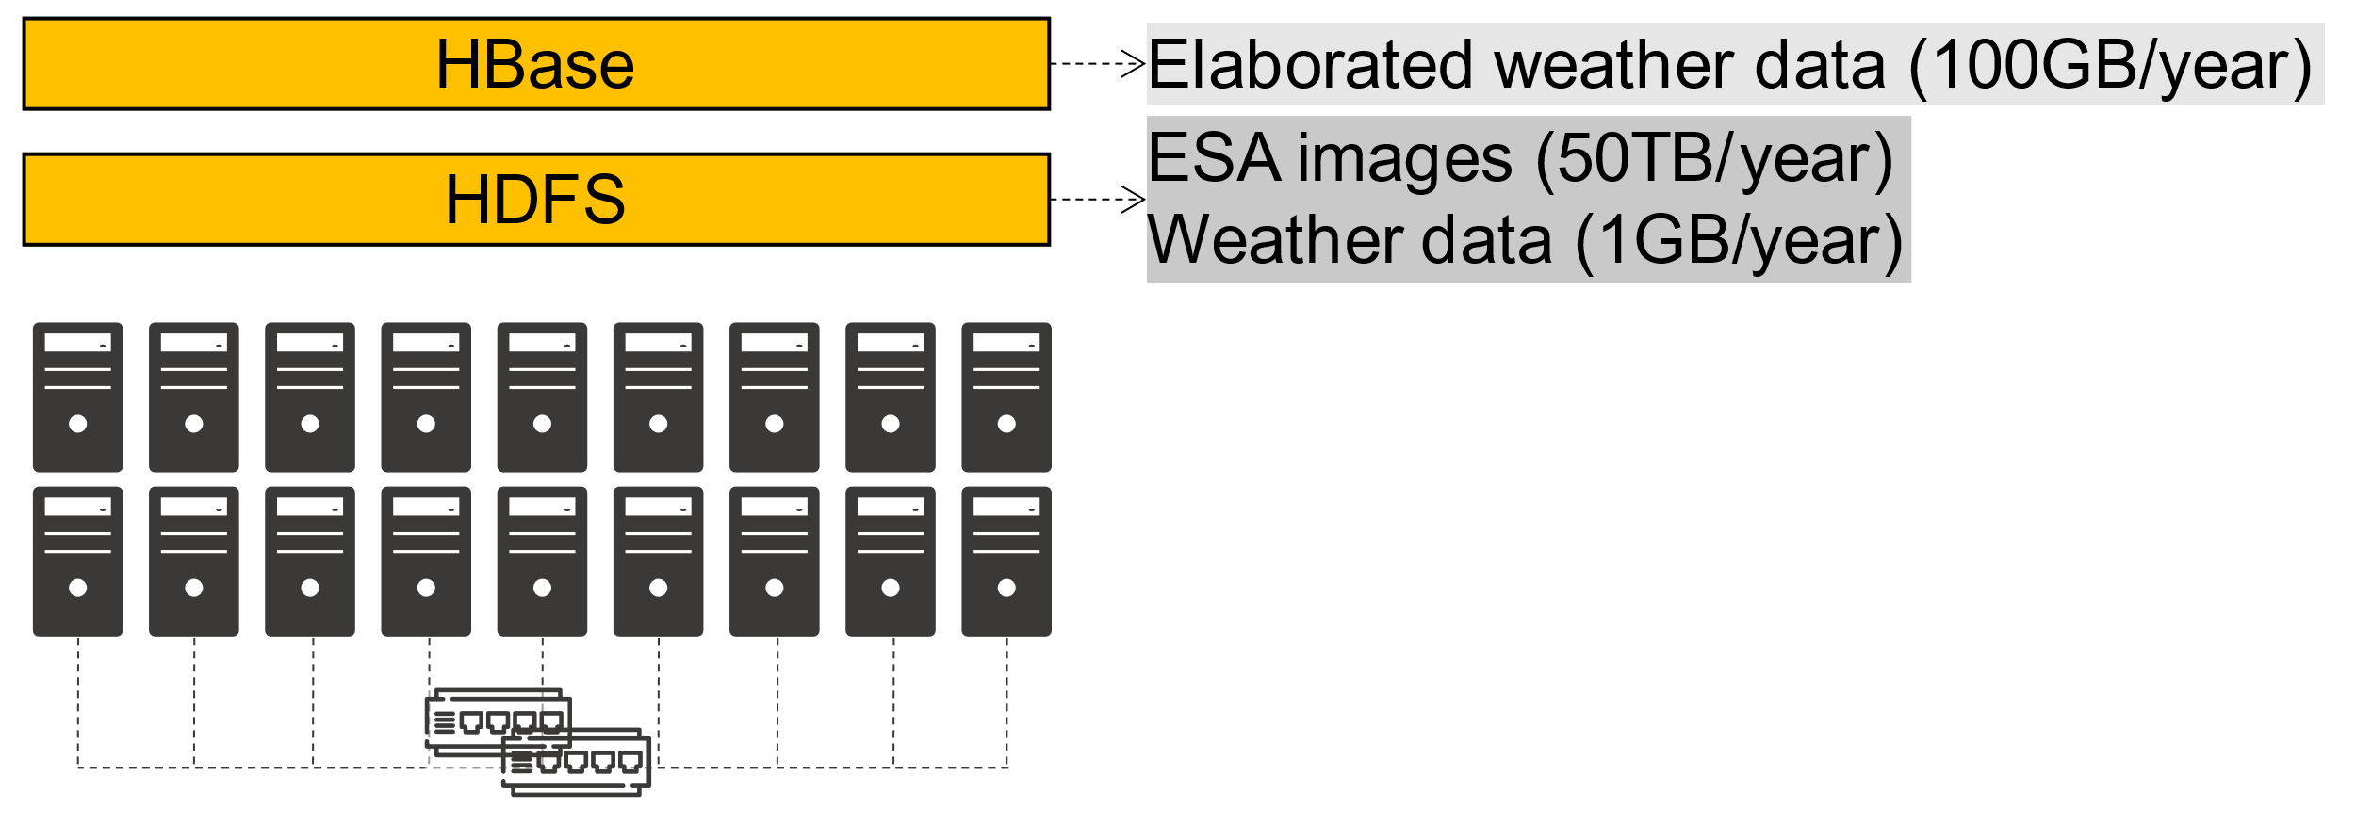
Migration
HDFS
How much durability do we need?
HP₀: three replicas (we stick to this)
HP₁: decrease replicas for cold data
HP₂: move cold data to glacier or delete id
...
HBase has marginal effects on the pricing (100GB << 50TB)
For simplicity, we can omit it
Overall: 50TB storage/year

Slide 16
Migration
Processing takes place each time that ESA provides a satellite image
Some days no images are available
Some days up to 10 images are available
Spark jobs are always executed with the same parameters
Image processing
4 machines, 2 cores, 10GB RAM at least
Weather processing is negligible
Hadoop
Cluster
Image processing
-
Resources
-
:
Oozie
4 Executors (2 cores and 10GB RAM each)
-
-
Driver (2 cores and 20GB RAM)
Frequency
: 0
-
Python
-
10 times/day
Timing
: 15m/core (2h total)
-
I/O
: 1GB
-
Docker
Spark
10GB
HBase
Weather processing
-
Resources
-
:
2 Executors (1 core and 500MB RAM each)
-
HDFS
-
Driver (1 core and 1GB RAM)
Frequency
: 0
-
-
10 times/day
Timing
: 0.5 m/core (1m total)
-
I/O
: 10
-
100MB

Slide 17
Migration
 | On-premises | On cloud
Hardware | 2356€/year | 36000$/year
Software | 100000€/year | ?
Assuming 1 Executor = 1 Machine
Compare 4 machines on-premises vs on cloud
On-premises
4 machines: 10602€/year / 18 machines x 4 machines = 2356€/year
Cloudera requires at least 10 nodes: 100000€/year
AWS
4 EC2 instances: 162000$/year / 18 machines x 4 machines = 36000$/year

Slide 18
Migration
AWS
Still, we have no software stack configuration
Which is the major cost?

Slide 19
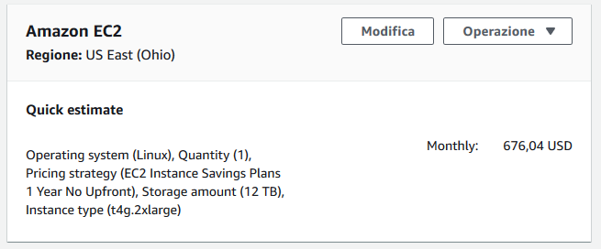
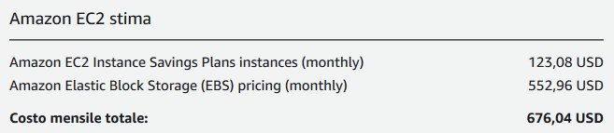
Migration
AWS
Still, we have no software stack configuration
Which is the major cost?

Slide 20
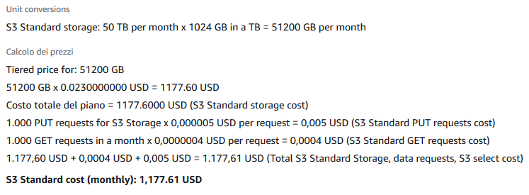
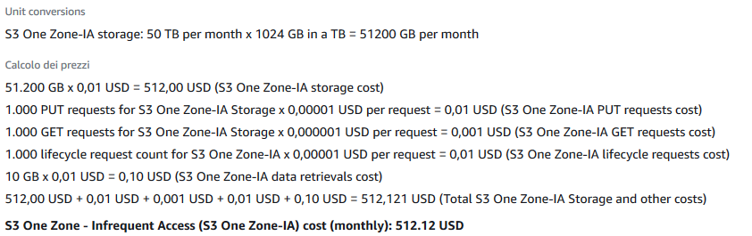
Migration
S3 standard
S3 Infrequent Access

Slide 21
Motivation
Amazon EMR (Elastic Map Reduce)
Provides a managed Hadoop framework
Some features
Service integration
Automatically control EC2 instances
Transparently use S3 storage
Pricing:
Low Hourly Pricing
Amazon EC2 Spot Integration
https://aws.amazon.com/emr

Slide 22








EMR Cluster
Deploy Multiple Clusters
Provision as much capacity as you need
Add or remove capacity at any time
Resize a Running Cluster

Slide 23


EMR Cluster
EMR cluster
Master group controls the cluster
Coordinate the work distribution
Manage the cluster state
Core groups
Core instances run Data Node daemons
(Optional) Task instances
Amazon EMR Cluster
Master Instance Group
Core Instance Group
Task Instance Group
HDFS
HDFS

Slide 24
EMR Cluster
The central component of Amazon EMR is the cluster
A collection of Amazon Elastic Compute Cloud (Amazon EC2) instances
Each instance is called a node
The node type identifies the role within the cluster
Master node coordinates the distribution of data and tasks among other nodes
Every cluster has (at least) a master node
Always active
Core node runs tasks and store data in the Hadoop Distributed File System (HDFS)
Multi-node clusters have at least one core node
Always active, contains the data node daemon
Task node only runs tasks
Task nodes are optional
Decoupling processing and storage, we lose data locality

Slide 25
Migration
On-Demand Instance
Pay for compute capacity by the hour (minimum of 60 seconds)
No long-term commitments
Spot Instance
Unused EC2 instance that is available for less than the on-demand price
Hourly price is called spot price
Adjusted based on long-term supply and demand for spot instances
Run the instance when capacity is available and price is below threshold
When data-center resources are low, spot instances are dropped
Mainly suitable for batch workloads
https://aws.amazon.com/ec2/pricing/

Slide 26
Migration
Spot Instance cost strategies
Capacity-optimized strategy
Allocated instances into the most available pools
Look at real-time capacity data, predict which are the most available
Works well for workloads such as big data and analytics
Works well when we have high cost of interruption
Lowest-price strategy
Allocates instances in pools with lowest price at time of fulfillment

Slide 27
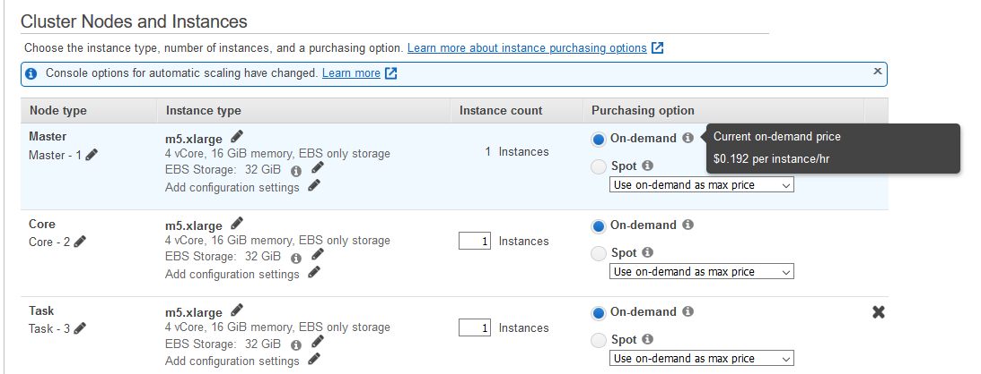
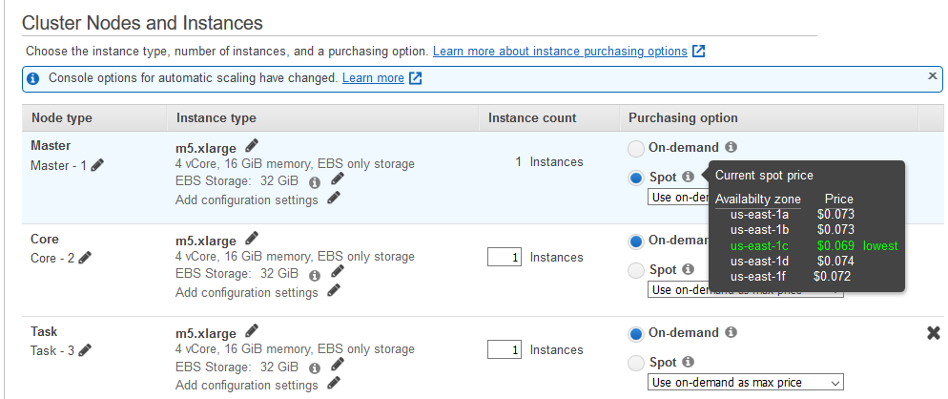
Creating the cluster

Slide 28
EMR
Choose to launch master, core, or task on Spot Instances
The master node controls the cluster
When terminated, the cluster ends
Use spot instances if you are running a cluster where sudden termination is acceptable
Core nodes process data and store information using HDFS
When terminated, data is lost
Use spot instances when partial HDFS data loss is tolerable
Task nodes process data but do not hold persistent data in HDFS
When terminated, computational capacity is lost
The effect of spot instances on the cluster is "minimal"
https://docs.aws.amazon.com/emr/latest/ManagementGuide/emr-plan-instances-guidelines.html

Slide 29
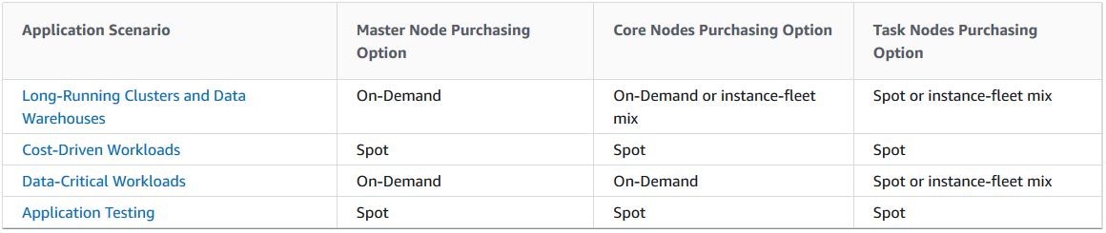
EMR

Slide 30
Add some storage
Amazon EMR provides two main file systems
HDFS and EMRFS, specify which file system to use by the prefix
hdfs://path (or just `path`)
HDFS is used by the master and core nodes
AWS EBS volume storage is used for HDFS data
Is fast, best used for caching the results produced by intermediate job-flow steps, why?
It’s ephemeral storage which is reclaimed when the cluster ends
s3://DOC-EXAMPLE-BUCKET1/path (EMRFS)
An implementation of the Hadoop file system atop Amazon S3
We can avoid EBS storage
https://docs.aws.amazon.com/emr/latest/ManagementGuide/emr-plan-storage.html

Slide 31
Migration
 | On-premises | On cloud
Hardware | 2356€/year | ?
Software | 100000€/year | ?
Migrating cluster to EMR: ?
Given the software requirements, we need
(At least) 1 x Master Node (to manage the cluster) (At least) 1 x Core node (with HDFS/EBS)
4 x Task Nodes (to compute)
Hadoop
Cluster
Image processing
-
Resources
-
:
Oozie
4 Executors (2 cores and 10GB RAM each)
-
-
Driver (2 cores and 20GB RAM)
Frequency
: 0
-
Python
-
10 times/day
Timing
: 15m/core (2h total)
-
I/O
: 1GB
-
Docker
Spark
10GB
HBase
Weather processing
-
Resources
-
:
2 Executors (1 core and 500MB RAM each)
-
HDFS
-
Driver (1 core and 1GB RAM)
Frequency
: 0
-
-
10 times/day
Timing
: 0.5 m/core (1m total)
-
I/O
: 10
-
100MB

Slide 32
Migration
 | On-premises | On cloud
Hardware | 2356€/year | 8000€/year
Software | 100000€/year | ?
Migrating cluster to EMR: ~8000€/year
https://calculator.aws/#/estimate?id=c3780b12bb43b593d05def5a1d5218d9764b8a65

Slide 33
Migration
 | On-premises | On cloud
Hardware | 2356€/year | 14710€/year
Software | 100000€/year | ?
Migrating cluster to EMR: 14710€/year
S3 Infrequent Access storage (50 TB per month): 640€
1 x Master EMR nodes, EC2 (m4.xlarge), Utilization (75 h/month): 4.5€
75 h/month = 15min/task x 10task/day x 30day/month / 60min/hour
1 x Core EMR nodes, EC2 (m4.xlarge), Utilization (75 h/month): 4.5€
4 x Task EMR nodes, EC2 (m4.4xlarge), Utilization (75 h/month): 72€
4 x EC2 on demand (task node): 174.83€
Storage amount (30 GB)
Workload (Daily, Duration of peak: 0 Hr 15 Min)
Instance type (m4.xlarge)
2 x EC2 on demand (master and core nodes): 330€
Storage amount (30 GB)
Instance type (m4.xlarge)

Slide 34
Migration
 | On-premises | On cloud
Hardware | 2356€/year | 13445€/year
Software | 100000€/year | ?
Migrating cluster to EMR: 13445€/year
S3 Infrequent Access storage (50 TB per month): 640€
1 x Master EMR nodes, EC2 (m4.xlarge), Utilization (75 h/month): 4.5€
75 h/month = 15min/task x 10task/day x 30day/month / 60min/hour
1 x Core EMR nodes, EC2 (m4.xlarge), Utilization (75 h/month): 4.5€
4 x Task EMR nodes, EC2 (m4.4xlarge), Utilization (75 h/month): 72€
4 x EC2 spot (task node): 69.55€
Storage amount (30 GB)
Workload (Daily, Duration of peak: 0 Hr 15 Min)
Instance type (m4.xlarge)
2 x EC2 on demand (master and core nodes): 330€
Storage amount (30 GB)
Instance type (m4.xlarge)

Slide 35
Migration
Summing up
We estimated the cluster costs
On-premises solution with 18 machines: no go
Cloud solution with 18 EC2 instances: no go, we miss the software configuration
We reduced the cluster based on software requirements
On-premises solution with 4 machines: no go
Cloud solution with 4 EC2 instances: no go, we miss the software configuration
We moved the cluster to AWS EMR + spot instances + S3 storage
Can we do better?
Pick ad-hoc cloud services (AWS Lambda e AWS Batch)
... to re-think the applications (food for thoughts)

